Slide 1
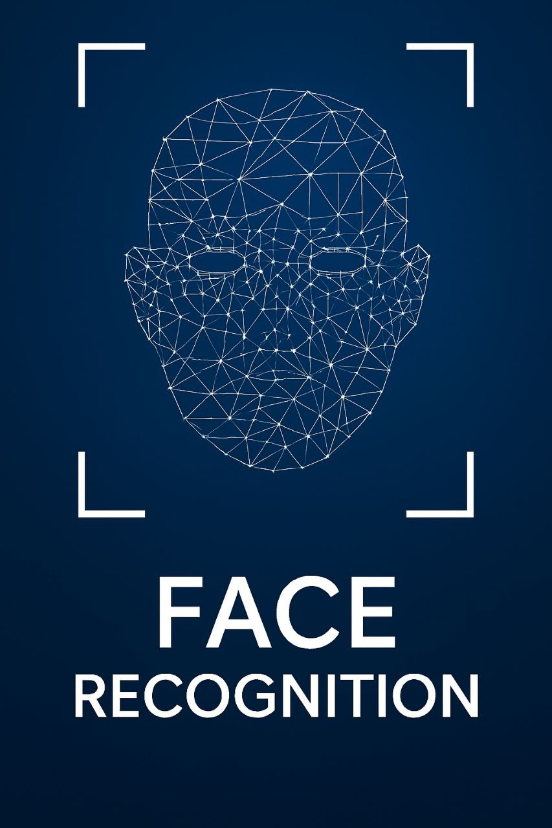

Face Recognition with pythonAI
by : jaafar ali muter and sajad ali

Slide 2
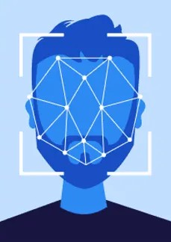
Abstract
This project focuses on building a real-time face recognition system using Python and artificial intelligence. Face recognition technology is widely used in security, authentication, and surveillance systems. The system detects and identifies faces from images or video streams, providing an accurate and fast solution for various applications. In this project, we use powerful Python libraries such as OpenCV, face_recognition, and NumPy to achieve high-accuracy results.

Slide 3
Introduction
Face recognition is a biometric method of identifying or verifying a person based on their facial features. Unlike traditional password-based systems, face recognition provides a contactless, efficient, and reliable way of authentication. The goal of this project is to design a Python-based system capable of detecting faces, extracting facial features, and comparing them with a database of known faces in real-time.

Slide 4
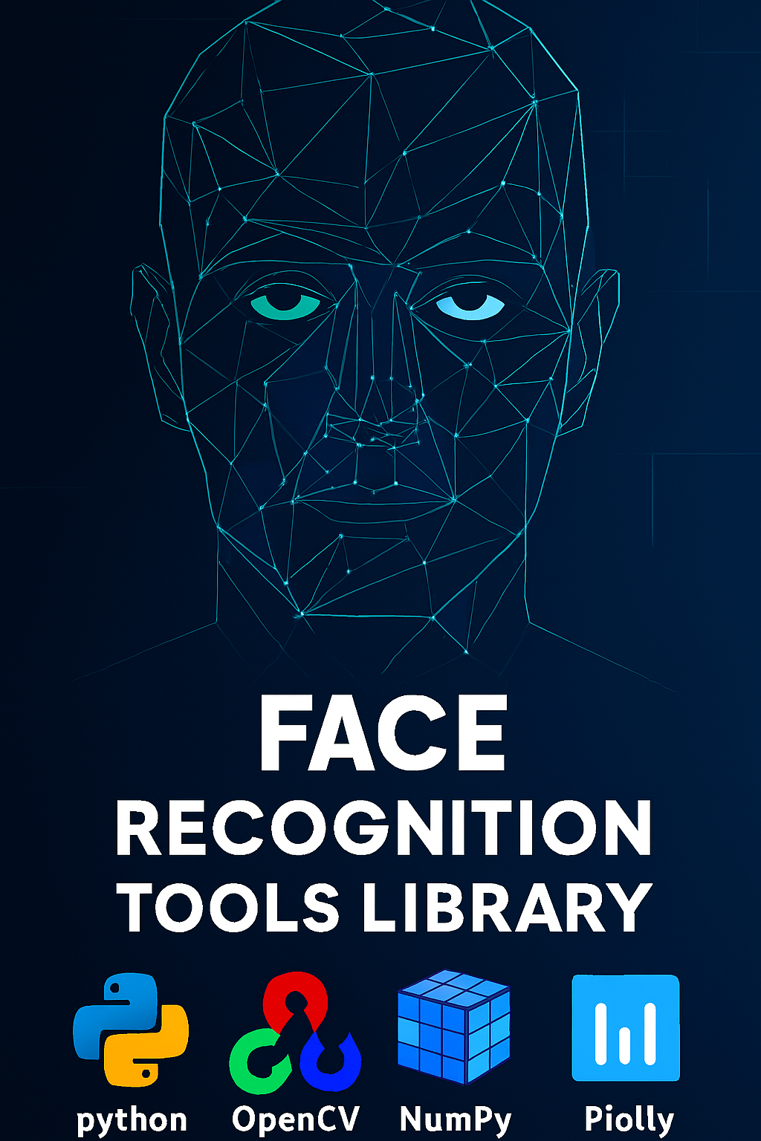
Main Libraries and Functions Explained
cv2 (OpenCV): Used for image processing, displaying images, drawing rectangles and text.
face_recognition:Detects faces, computes face encodings, and compares unknown faces with known faces.
numpy (np):Handles arrays and numerical operations. Useful for computing distances between face encodings.
Pillow (PIL):Opens and converts images to RGB format compatible with OpenCV.
requests:Fetches images from URLs. Handles HTTP requests and responses.
base64 & re: Used for decoding images from Base64 strings (data URLs) and applying regex operations.

Slide 5
Methodology
The project is divided into three main phases:
1 - Loading the image from url link that we brought from google or any browser.
2 - The program analyzes the image and all features of the people in it.
3 - then it searches through the (Known faces) file to find the owner of the picture using face_recognition library.
4 - Extract 128-dimensional facial embeddings for each detected face.

Slide 6
Results:
The system successfully detects and recognizes faces in real-time. The recognition accuracy depends on the quality of images and the lighting conditions. The system can be enhanced by:
Increasing the dataset size.
Applying image preprocessing techniques like histogram equalization.
Using more advanced AI models such as deep convolutional neural networks (CNNs) for better feature extraction.

Slide 7
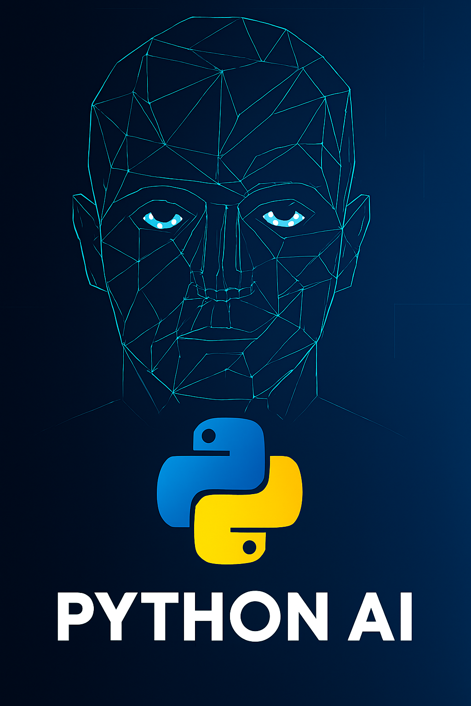
Conclusion
This project demonstrates how Python and AI can be used to create a robust face recognition system. Such systems have practical applications in security, smart home devices, attendance tracking, and personalized user experiences. By leveraging libraries like OpenCV and face_recognition, developers can build high-performance facial recognition applications with minimal effort.

Slide 8
import cv2 import face_recognition import numpy as np import os import requests import base64 import re from io import BytesIO from PIL import Image import tkinter as tk from tkinter import simpledialog, messagebox

